Slide 1
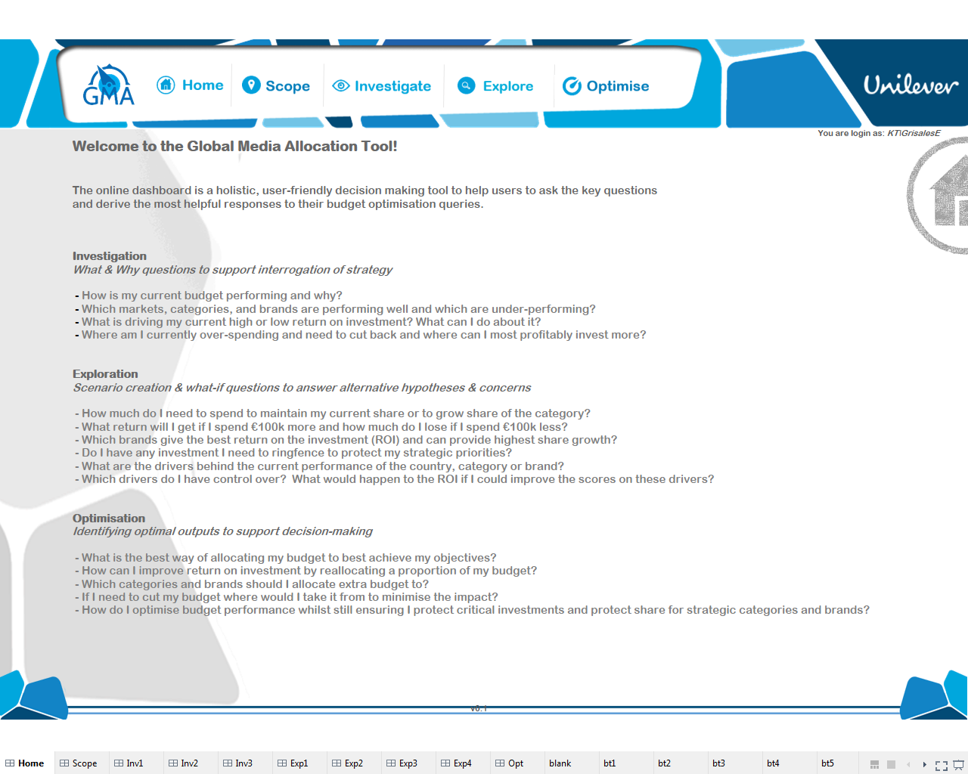

Slide 2
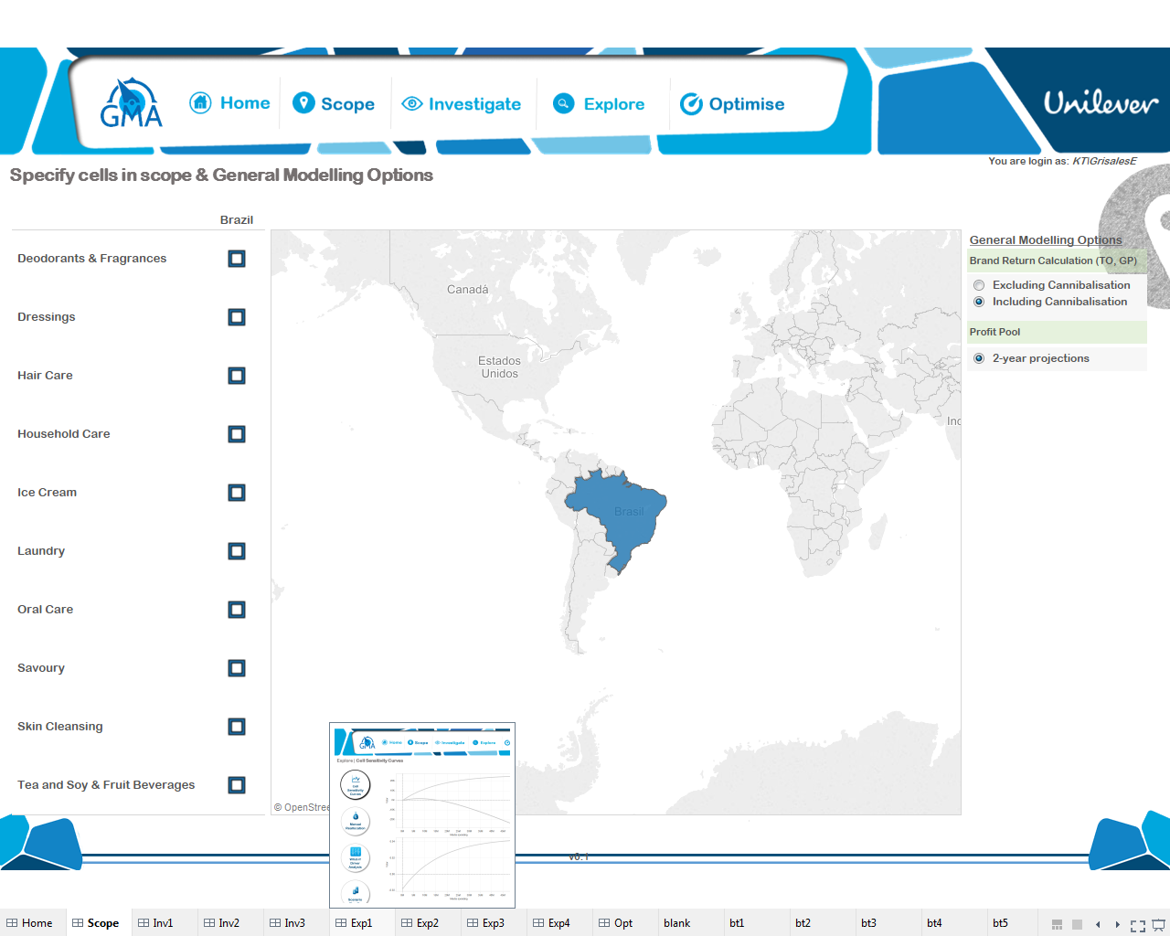

Slide 3
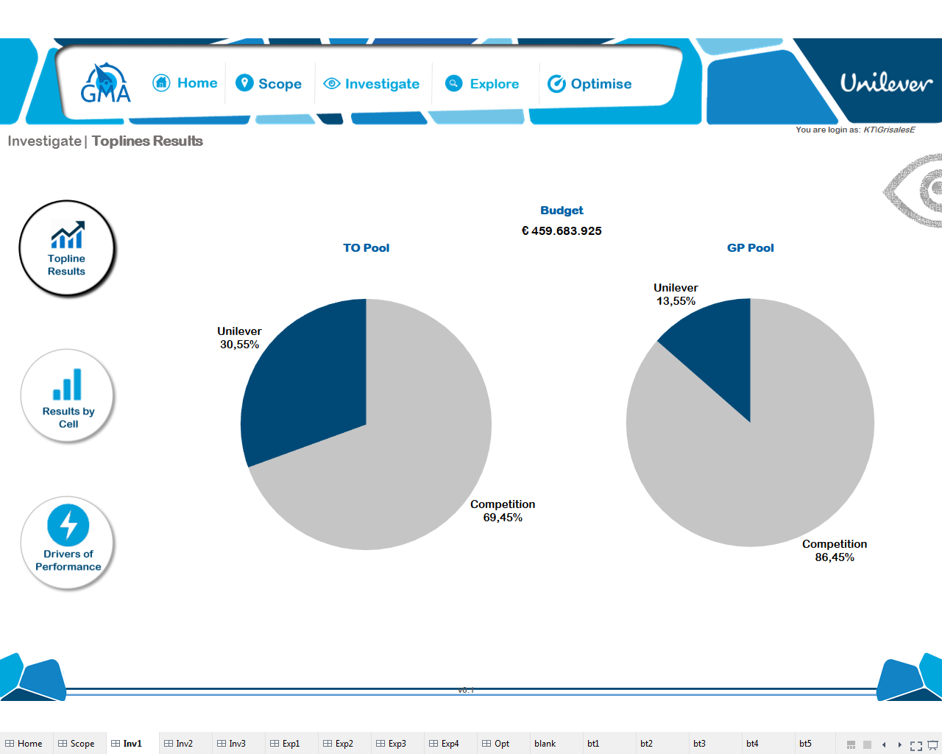
Kill.
Replace with Bubble chart as next page.

Slide 4



Topline Results
Key Figures
Return Map and Profit Pool size
By Turnover (TO)
By Gross Margin (GM)
Budget
€25,000,000
…TO or GM accordingly
Turnover (TO)
Profit Pool
€300,000,000
Return/Budget =1
line
Return
€56,000,000
Return (€ MM)
Gross Margin (GM)
Profit Pool
€200,000,000
Bubble size = Profit Pool (TO or GM accordingly)
Return
€35,000,000
Budget (€ MM)

Slide 5
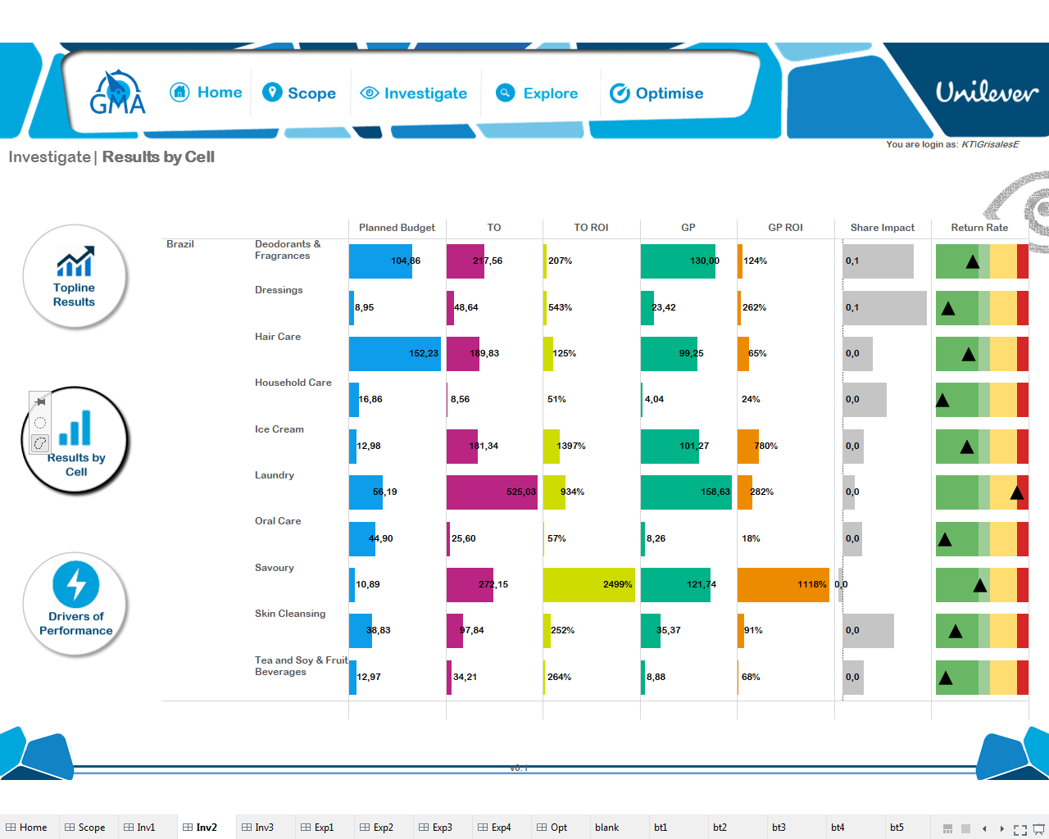

Slide 6
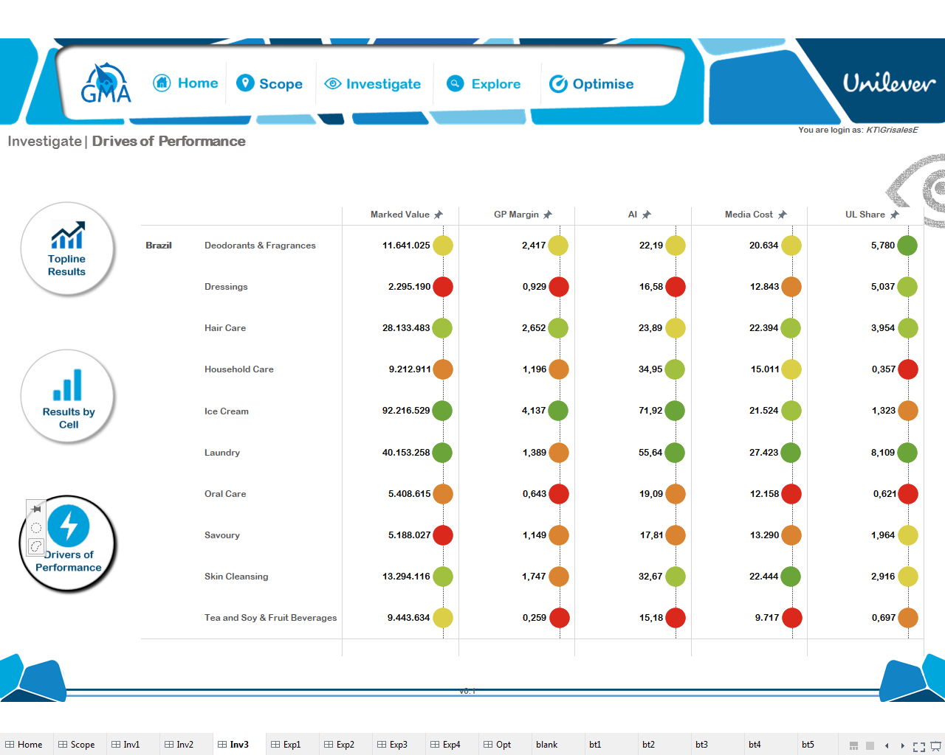

Slide 7
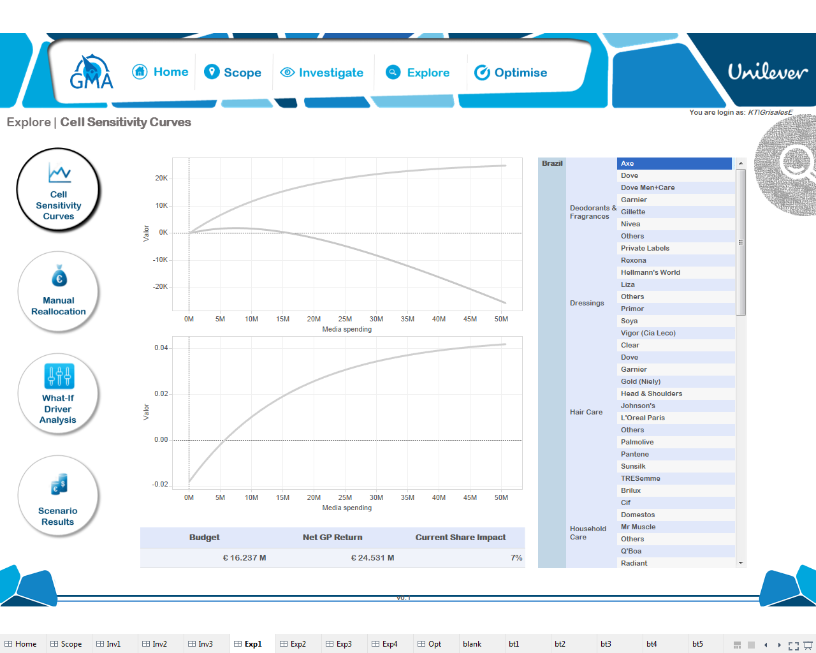

Slide 8
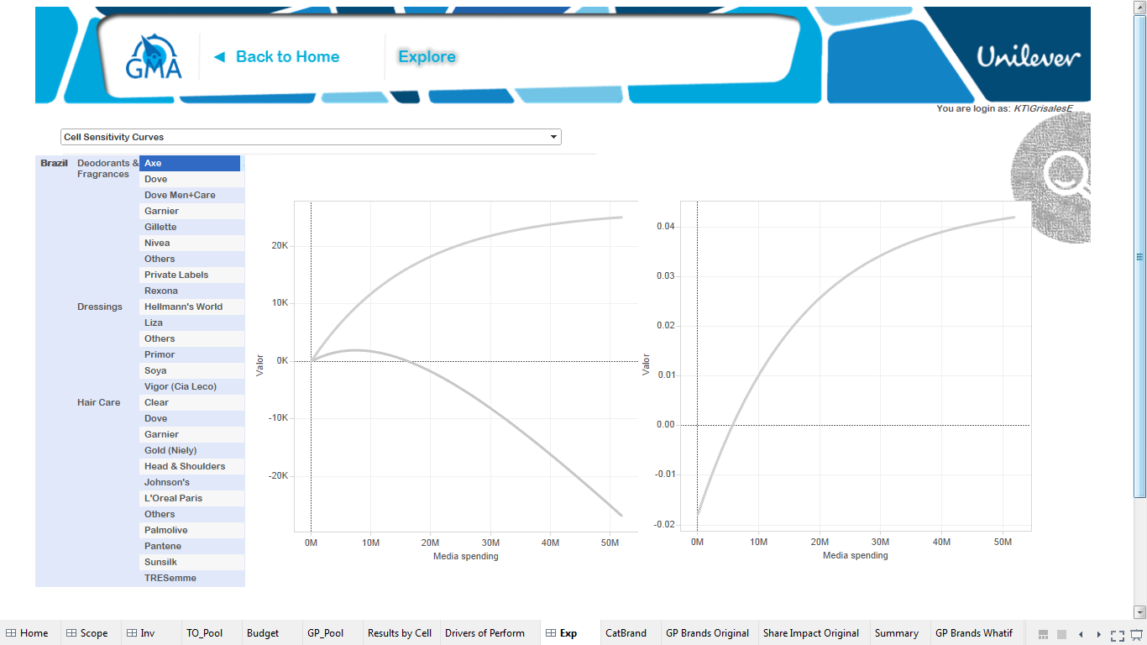
Add option to select curves to show: TO, GP, Net TO, Net GP
Return Curves
Share Impact (+-)
Net TO
Hover to show values
Add category curves with stable brand share as discussed
Change Filtering Style as next page
PBO
Include ONLY
Unilever brands

Slide 9
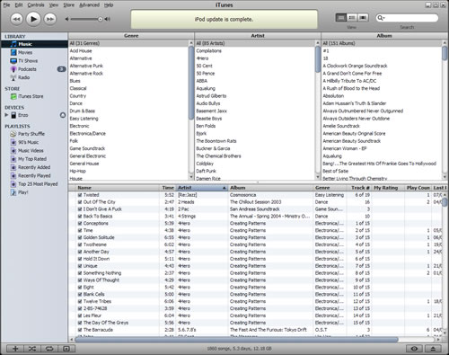
Market
Brazil
…
…
Category
Deo
Dressings
…
Brand
Axe
Dove
…

Slide 10
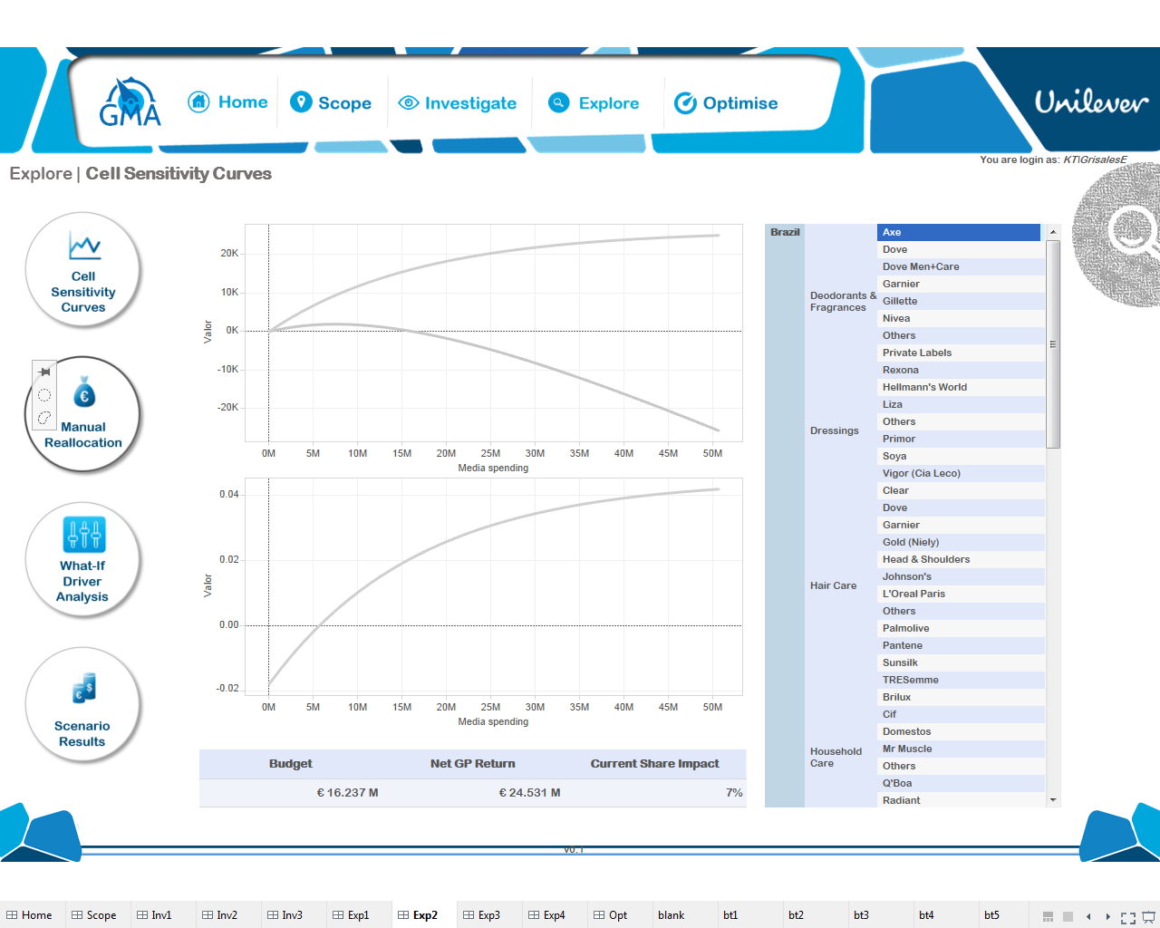

Slide 11
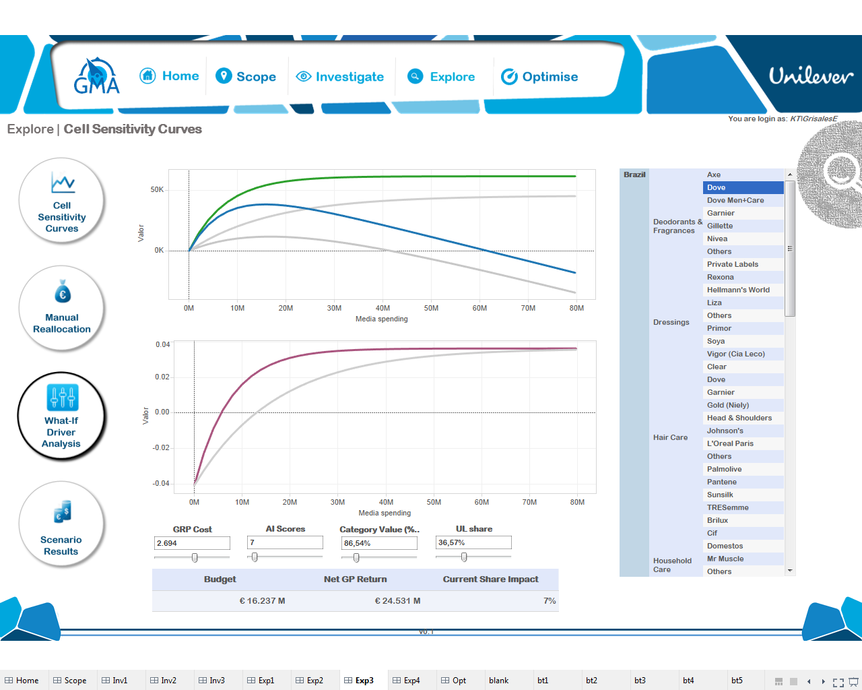

Slide 12
